Slide 1

The 8th Annual
Courageous Worship Church Women’s Ministry Brunch
Sponsorship Prospectus
God, I Say Yes!
Luke 1:38 (New Message)
Courageous Worship Church
October 3, 2026
10:30 AM – 12:30 PM
6865 Factory Shoals Road, Austell, Georgia 30168
Don’t wait! Sponsorship opportunities sell out quickly.
As always, we are committed to providing quality services to you and appreciate your business and continued support.) For more information, please contact Lady Natasha Freeman at wearecourageousworshipchurch@gmail.com or (404) 680-8991.

Slide 2
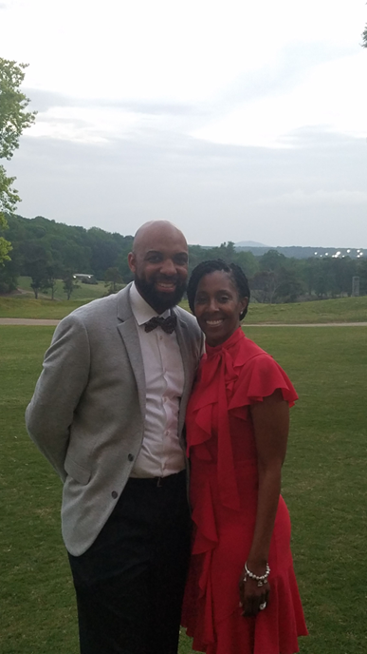
Dear Family and Friends,
The Courageous Worship Church Women’s Ministry is a 501(c)(3) nonprofit organization committed to empowering women and strengthening communities through impactful outreach, leadership development, and purposeful engagement. Serving more than 100 individuals, the ministry creates meaningful opportunities that inspire growth, connection, and lasting transformation.
Guided by a vision to create measurable impact, the ministry actively partners with organizations and sponsors who share a commitment to uplifting communities and investing in lasting change. Proceeds from this initiative will support a scholarship foundation established in honor of Eboni, whose life and legacy continue to inspire. Her journey with lupus fuels a deeper purpose: to raise awareness and create opportunities for others to thrive.
Through faith, service, and intentional outreach, the Courageous Worship Church Women’s Ministry extends its impact beyond the church, building pathways for education, empowerment, and generational change.
We are honored to invite you to support and sponsor the 8th Annual Courageous Worship Church Women’s Ministry Brunch, themed “God, I Say Yes.” This signature event brings together women, leaders, and community partners for a powerful experience of inspiration, connection, and purpose.
As a sponsor, you will gain meaningful visibility while aligning your brand with a mission-driven initiative that directly impacts lives, strengthens communities, and creates lasting change. This is an opportunity to connect with an engaged audience and demonstrate your commitment to purpose and community leadership.
The event will be held at Courageous Worship Church, 6865 Factory Shoals Road, Austell, Georgia 30168, on October 3, 2026, from 10:30 AM to 12:30 PM.
For sponsorship opportunities or to create a customized partnership, please contact Lady Natasha Freeman at wearecourageousworshipchurch@gmail.com or 404.680.8991.
With sincere gratitude,
Alvin J. Freeman and Natasha R. Freeman
Alvin J. Freeman and Natasha R. Freeman
Lead Pastor and Lady Freeman
www.wearecourageousworshipchurch.org
Alvin J. Freeman and Natasha R. Freeman
Lead Pastor and Lady Freeman
2

Slide 3
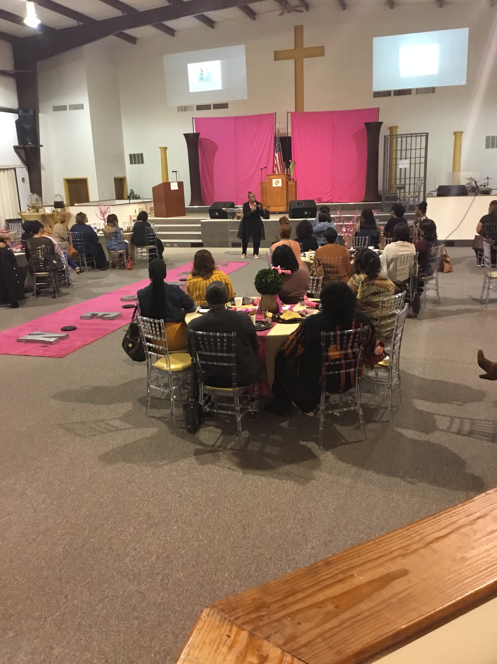
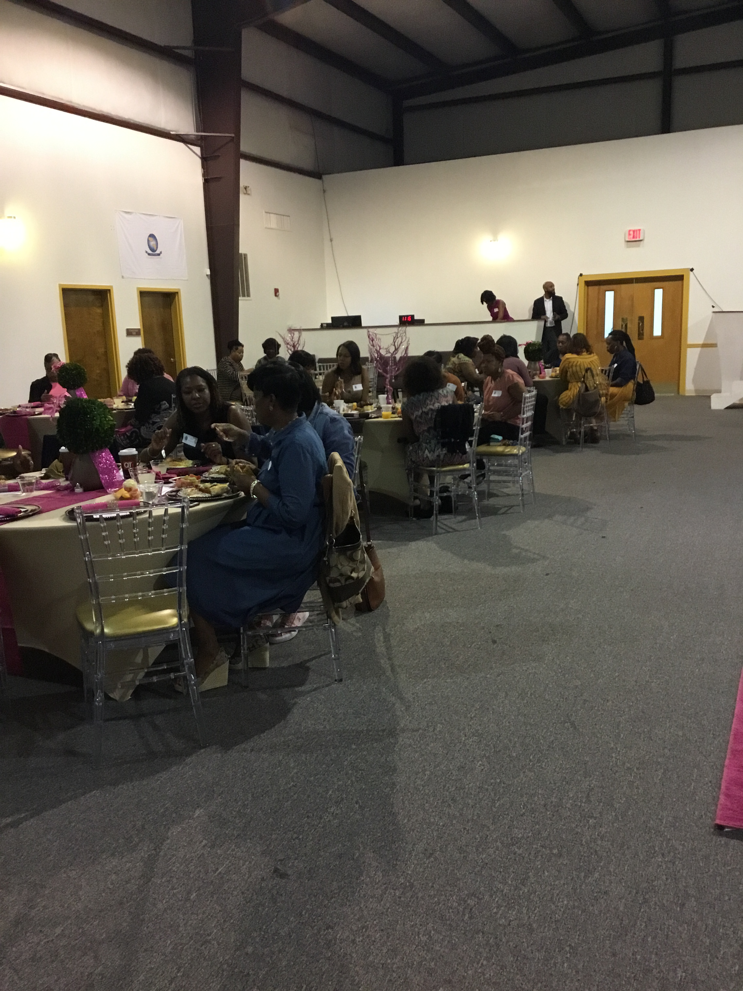
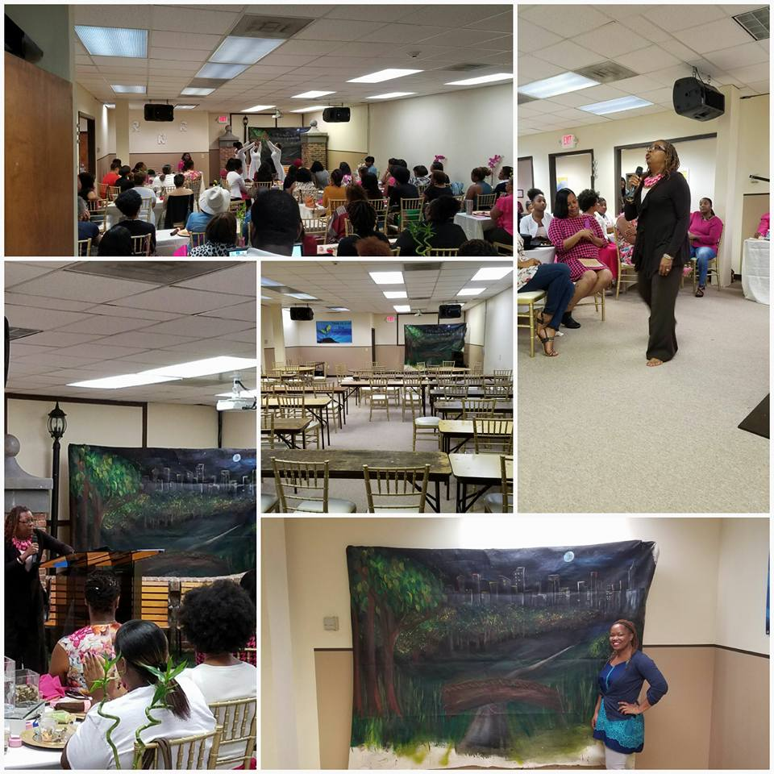
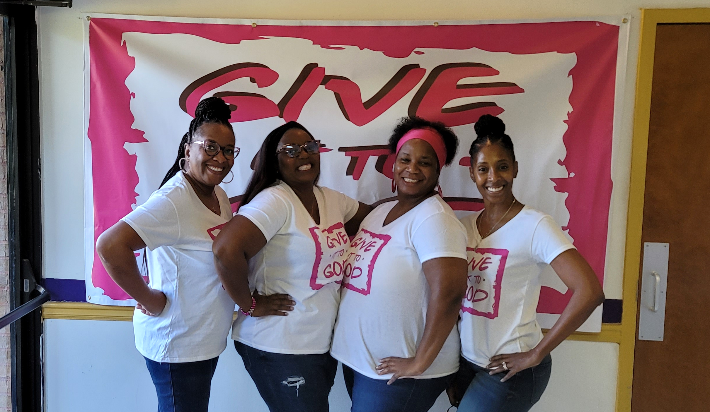
Connect to the Mission
The Courageous Worship Church Women’s Ministry’s mission:
Fostering a Holistic Approach to Ministering to the Mind, Body, and Soul.
The Courageous Worship Church Women’s Ministry is known to foster a holistic approach to ministry by nurturing the mind, body, and soul. We are committed to empowering women through faith, fellowship, and spiritual growth, equipping them to walk boldly in their God-given purpose and live transformed lives in Christ.
Contact Lady Natasha Freeman at wearecourageousworshipchurch@gmail.com or 404.680.8991​

Slide 4
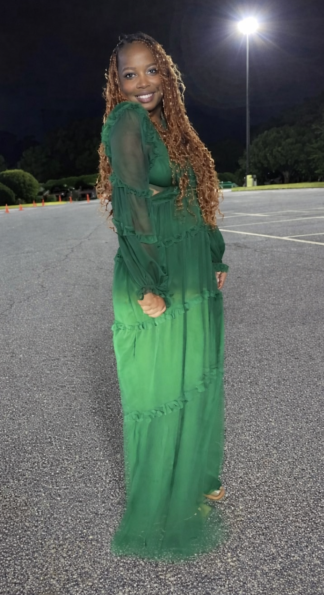
Eboni Rodriguez Memorial Scholarship
A Legacy of Strength & Faith
This event is dedicated in loving memory of Eboni Rodriguez, whose life embodied strength, grace, and unwavering faith.
Despite her battle with lupus, Eboni remained courageous, inspiring everyone around her to trust God through every season.
50% of all net proceeds will be awarded to a scholarship recipient in honor of Eboni Rodriguez.
Scholarship Criteria
Essay Prompt
Selection Process
Applicants must:
Be a current junior or senior attending a Georgia high school
Have a minimum GPA of 3.2
Plan to attend an accredited college, university, or trade school
Be actively involved in a local church or ministry
Demonstrate good character, leadership, and community involvement
Submit a personal essay reflecting resilience, faith, or overcoming challenges
“What does saying ‘yes’ to God mean in your life, and how has it shaped your journey, challenges, or future goals?”
Applications reviewed by a Scholarship Committee
Selection based on:
Academic achievement
Faith commitment & church involvement
Character and leadership
Essay quality
Award & Distribution Details
One (or more) scholarship recipient(s) annually
Funds may be used for:
Transparency Statement
  Tuition
  Books
  Educational expenses
All scholarship funds will be distributed directly to the recipient’s accredited institution and will not be issued to the student, parent, or guardian.
Net proceeds are defined as total event revenue after direct event expenses. A minimum of 50% will be allocated to the scholarship fund.
Preferred Considerations
Demonstrated financial need
Consistent participation in community service or outreach
Contact Lady Natasha Freeman at wearecourageousworshipchurch@gmail.com or 404.680.8991

Slide 5
Sponsorship Opportunities
We offer flexible sponsorship levels tailored for individuals, groups, local businesses, and community partners who want to make a difference.
Your support directly contributes to empowering women, raising lupus awareness, and funding scholarships in honor of Eboni Rodriguez.
There is a place for every partner to give, serve, and make an impact
Contact Lady Natasha Freeman at wearecourageousworshipchurch@gmail.com or 404.680.8991.

Slide 6

 | Premier logo placement on all event materials (highest visibility)
 | One (1) complimentary VIP branded table (seating up to 8 guests)
 | 2–3 minutes speaking opportunity during the event program
 | 60-second branded sponsorship video featured during the event
 | Verbal recognition during the program
 | Inclusion in post-event communications and sponsor recognition
Platinum Sponsorship
$500
Contact Lady Natasha Freeman at wearecourageousworshipchurch@gmail.com or 404.680.8991​

Slide 7

 | Premier logo placement on all event materials (highest visibility)
 | 4 complimentary seats (table seats up to 8 guests)
 | 45-second branded sponsorship video featured during the event
 | Verbal recognition during the program
 | Inclusion in post-event communications and sponsor recognition
Gold Sponsorship
$250

Slide 8
 | Premier logo placement on all event materials (highest visibility)
 | 2 complimentary seats (seating up to 8 guests)
 | Inclusion in post-event communications and sponsor recognition
Silver Sponsorship
$100
Contact Lady Natasha Freeman at wearecourageousworshipchurch@gmail.com or 404.680.8991​

Slide 9
Community Impact
Your sponsorship helps provide:
Food and hospitality
Event materials
Outreach to women in the community
Together, we create meaningful impact.
Contact Lady Natasha Freeman at wearecourageousworshipchurch@gmail.com or 404.680.8991​

Slide 10
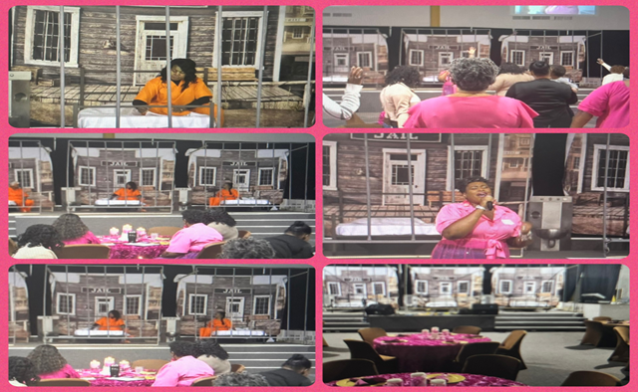

Slide 11
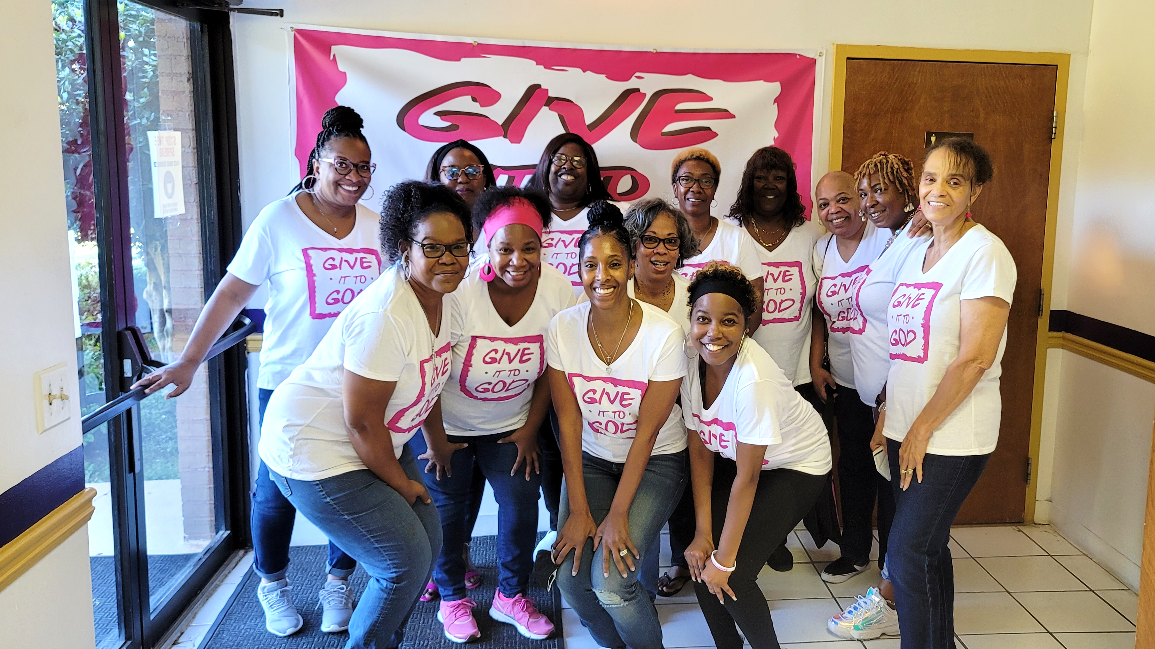
Partner With Us
Join us in making this event successful.
Contact Lady Natasha Freeman
wearecourageousworshipchurch@gmail.com or (404) 680-8991
@2026 God, I Say Yes. All rights reserved.

